Slide 1
Social Network Analysis
Computational Social Science
Lecture 6

Slide 2
Overview
Networks consider cases in the context of their relationship with other cases
Not just a method, but an entire discipline
Social science and mathematical traditions, terminology, questions
How network data is collected and represented
Centrality: Exerting influence within networks
Structures within networks
Dynamic processes on networks: changing attributes of cases
Dynamic networks: changing relationships between cases

Slide 3
Two traditions of network analysis
Social Sciences
Mathematical Sciences
Social Network Analysis
Originally sociometry, about 1920s
Focus on specific networks
Meaning of pattern of relationship
How influence is exerted
Terminology of: actors, ties, links, arcs
Mathematics: Graph Theory (1950s)
Other: Network Science (1980s)
Focus on properties of networks
Terminology of: vertices, nodes, edges

Slide 4
Different questions so different methods
Research in the social sciences is often concerned with the reason behind the network connections rather than the properties of the network structure itself.
Keeling & Eames 2005 – mathematical epidemiologists
Borgatti et al 2009 – social scientists
From a social scientist's point of view, network research in the physical sciences can seem alarmingly simplistic and coarse-grained. And, no doubt, from a physical scientist's point of view, network research in the social sciences must appear oddly mired in the minute and the particular, using tiny data sets and treating every context as different.

Slide 5
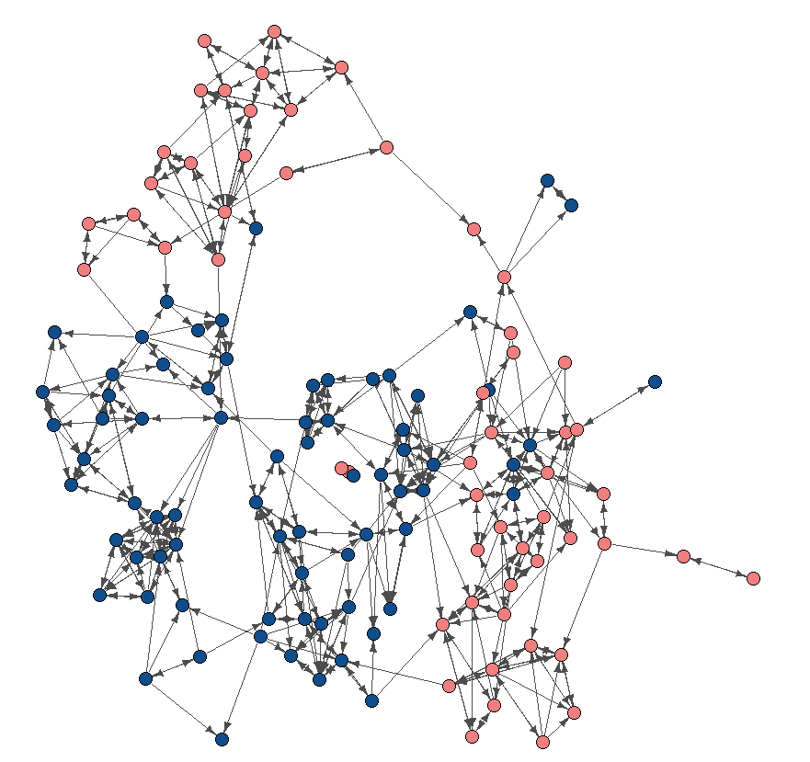
What is a network?

Slide 6
What is a network?
Cases or Entities
People, firms…
‘Nodes’ (or vertices, actors)
Relationship(s)
Friend, trade with…
‘Edges’ (or links, ties)
Network

Slide 7


Many types of relationships
Social Relations:
Perceptual (familiar)
Friends
Affectual (like, dislike)
Family, kinship
Co-occurrence:
Common group membership
Attendance of the same event
Close geographic proximity
Collaboration (music, research)

Slide 8

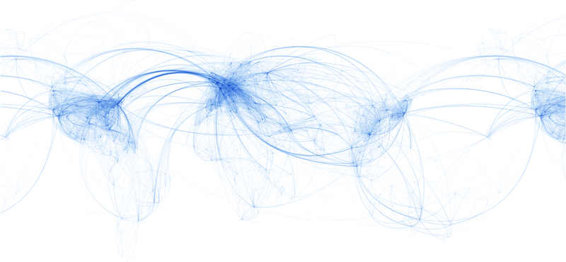
Many types of relationships
Flows:
Information
Capital, goods, trade
Transport routes
Interactions:
Influence (advice)
Activities (visiting)
Communication (email)
https://commons.wikimedia.org/wiki/File:World_airline_routes.png

Slide 9


Why social network analysis (or network science)?
Standard social science analysis methods do not effectively model relational structure and dynamics
Network analysis provides a set of tools to extend our intuition of the patterns that construct social structure
Visualisation to highlight patterns and structure obscured by the complexity of relationships
Develop theories about the way in which relationships influence social phenomena and processes
Empirically test such theories

Slide 10
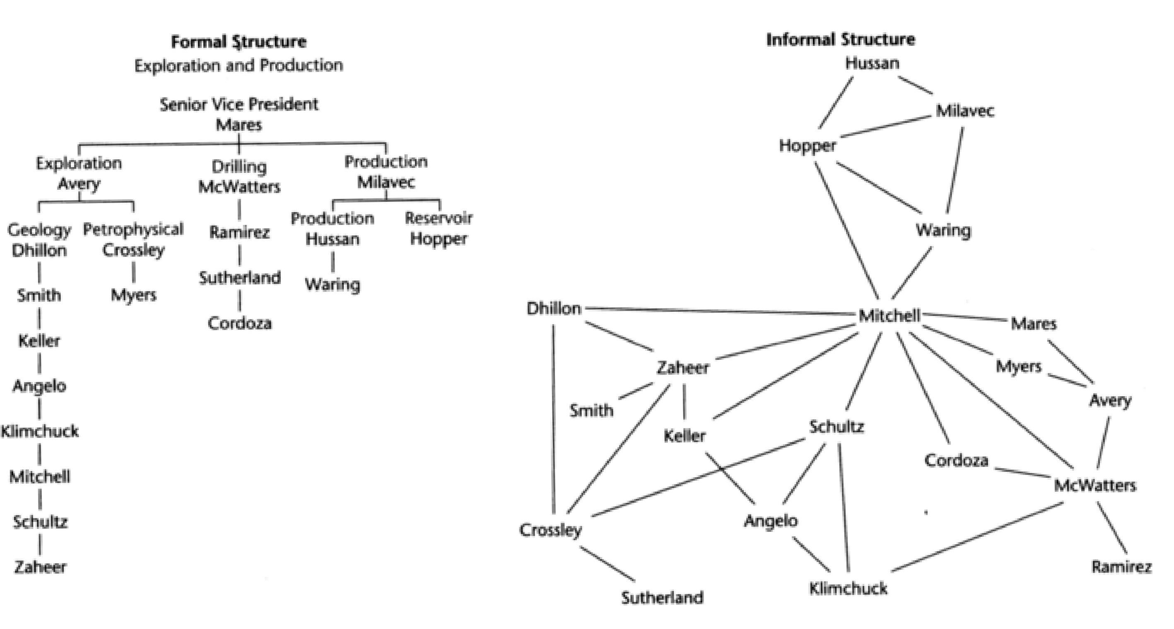
Network analysis provides tools for understanding structure Mismatch between relationships and formal hierarchy
Cross (2010). Improving leadership effectiveness through personal network analysis and development, in The Organizational Network Fieldbook (Fig 19.1)

Slide 11
Networks are a natural level at which to study society
…the survey is a sociological meatgrinder, tearing the individual from his social context… If our aim is to understand people’s behavior rather than to simply record it, we want to know about primary groups, neighborhoods, organizations, social circles, and communities; about interaction, communication, role expectations, and social control.
Allen H. Barton (1968)
Professor of Sociology, Columbia University
Director, Bureau of Applied Social Research

Slide 12
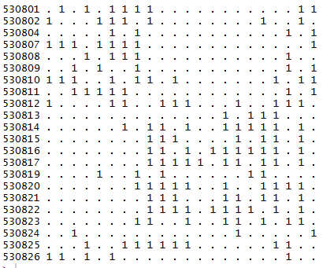
Collecting and Representing Network Data

Slide 13

Primary data collection: name generator
Respondent and their nominees processed to convert all names to unique identifiers
Question from Wellbeing in Schools 2016

Slide 14


Secondary network data
Social media data
Posts and replies, following
Administrative data
Membership
Trade flows
Transport
Scraping
Collaborations

Slide 15
Characteristics of relationships (edges)
Directed vs undirected
One way (eg nominate friend)
Bidirectional (eg marriage)
Weighted have a value on the edge
Ordinal: best friend vs friend vs acquaintance
Scale: amount of trade (annual) between firms
What if there’s more than one relationship over the same set of cases?
separate networks OR
multiplex

Slide 16
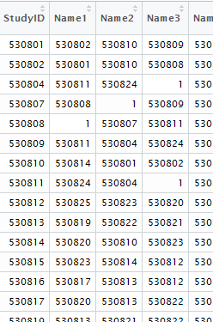
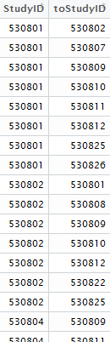
Representation: in datasets
Nodelist: looks like the
survey data
Edgelist: allows
edge attributes
Adjacency matrix: mathematically convenient

Slide 17
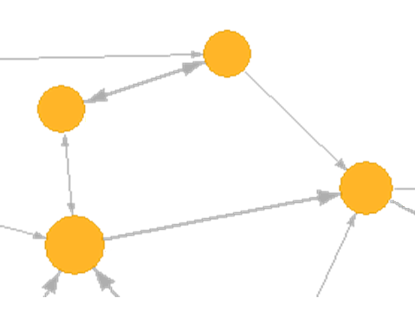
Representation: visual
Each case is represented as a node (vertex)
Each relationship between cases are represented as lines (edge)
Edges can vary in intensity (weight), represented by line thickness
Edges can be directional (arrow) or undirected (line, or double arrow)

Slide 18
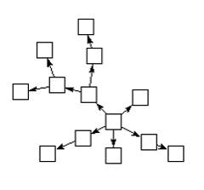
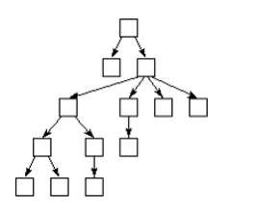
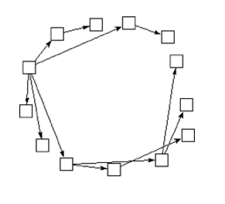
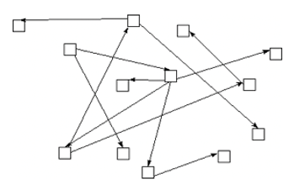
No standard layout: these are the same network

Slide 19
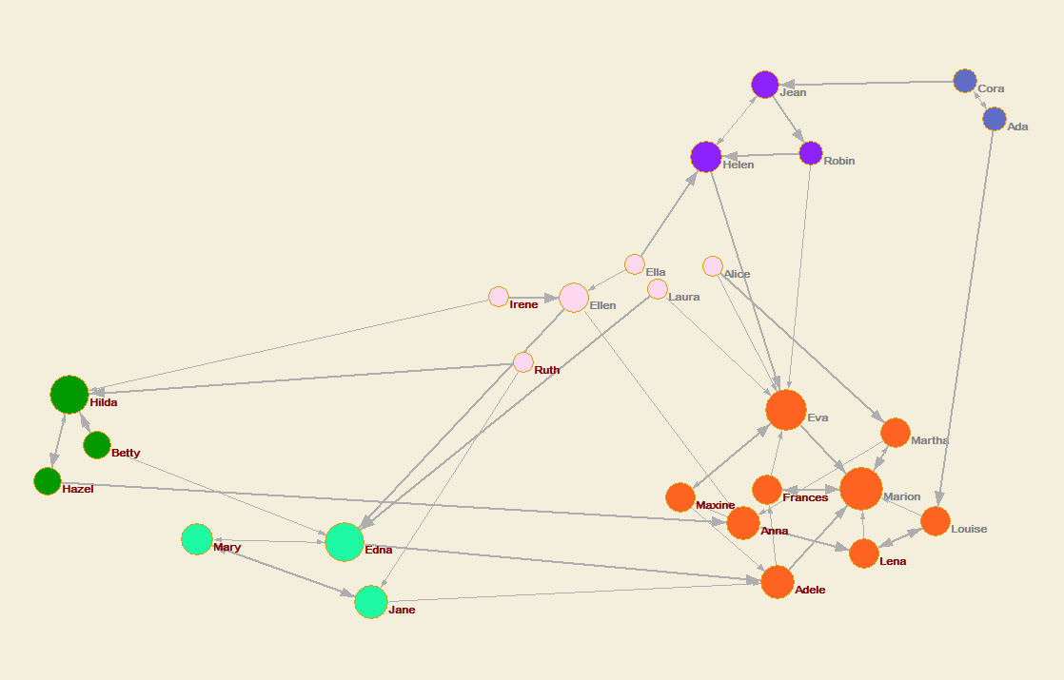
Layouts instead used to emphasise structures

Slide 20
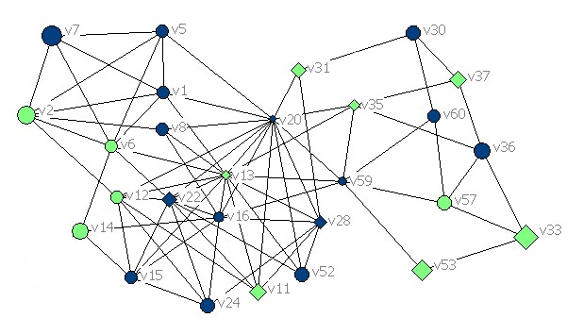
Colour, size, shape of nodes for different attributes

Slide 21
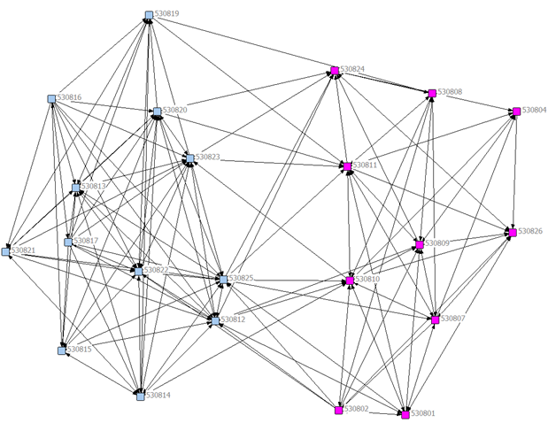
Appropriate visualisation reveals network properties
Secondary school friendships
Teenage Friends and Lifestyle Study (Glasgow)
Nodes coloured by gender
Notice that same gender edges are relatively dense
Many same gender friendships
Few mixed gender friendships
https://www.stats.ox.ac.uk/~snijders/siena/Glasgow_data.htm

Slide 22
Sources of error are particularly problematic in social network analysis
Missing cases/attribute data
Lack of data can undermine especially a sociocentric design as it renders the network incomplete and analysis circumspect
Misattribution of information/ties
Relying on subjective accounts of relations or information about other people may not be reliable and valid
Retrospection error
Requiring participants to recall interactions/ties might result in poor quality or inaccurate data
Imagine if this node (and its edges) is missing

Slide 23
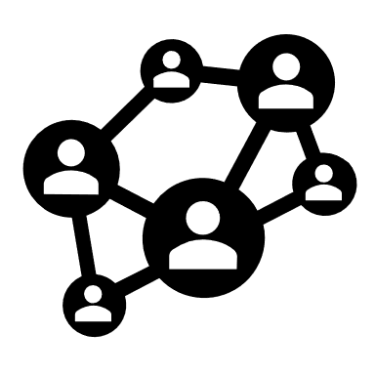
Ego networks

Slide 24
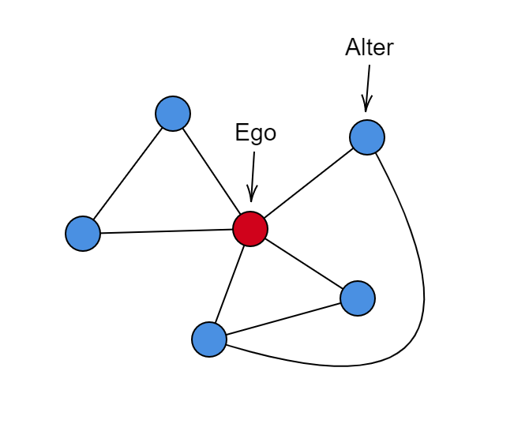
Ego-networks: relationships between a central case (egos) and the others cases (alters) they connect to
Image source: https://commons.wikimedia.org/wiki/File:Egocentric_Network.png

Slide 25
Analysis of ego networks
Used to sample from a larger group or network:
If the full network is too large to analyse as a whole
If the full network is not sufficiently connected and so cannot easily be traced
Popular in studies of social integration such as migration
Podolny and Barren (1997) studied career progression
Collected workplace ego-networks for 658 employees at the same firm
People with large, sparse networks of informal ties promoted more often and to higher levels
Joel M. Podolny and James N. Baron “Resources and Relationships: Social Networks and Mobility in the Workplace,” American Sociological Review, 62(5), pp 673-693

Slide 26
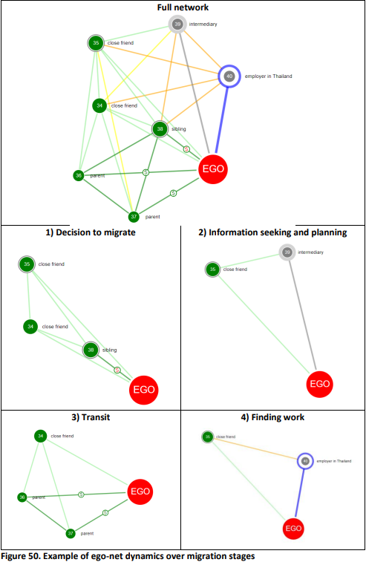
Relationships between alters critical for ego-networks
Primary data collection uses Name Interpreters
Understand how the people named connect with each other
For example: “Please think about the relations between the people you just mentioned. Some of them may be total strangers in the sense they wouldn’t recognise each other if they bumped into each other on the street. Others may be especially close, as close or closer as they are to you. First, think about NAME1 and NAME2. Are they total strangers? Are they especially close?”
(General Social Survey, 1985; cited in Knoke and Yang, 2008: 21)
McAlpine, AM (2021). Mediated labour migration in the Myanmar-Thailand corridor and precarious outcomes (PhD thesis LSHTM). doi: 10.17037/PUBS.04664161

Slide 27
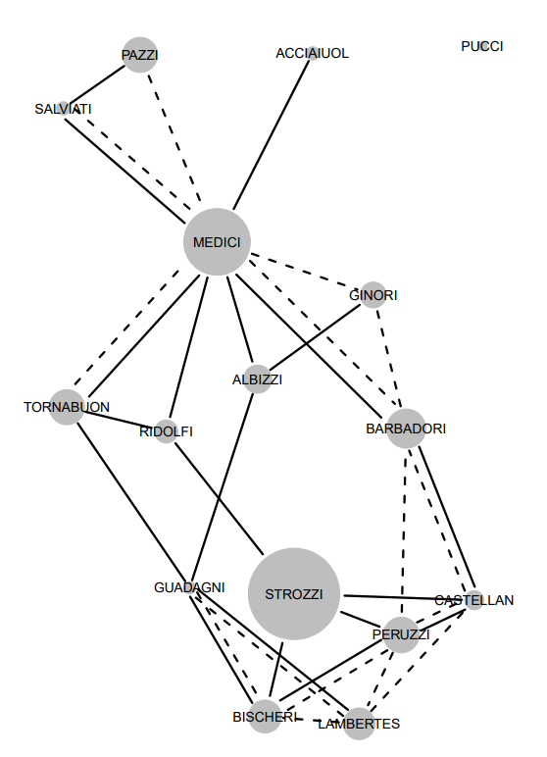
Our focus: whole network (socio-centric) analysis
Marriage
Business

Slide 28
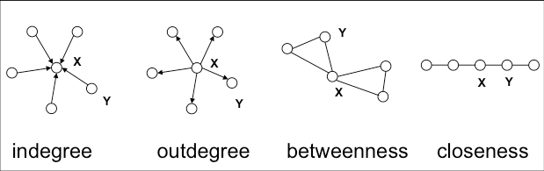
Centrality: Influence within network

Slide 29
Centrality
Centrality X > centrality Y for all networks shown
Centrality is a NODE level attribute
Concerns each node’s influence within a network
common measures are degree, betweenness and closeness
MANY other measures used
‘Best’ measure depends on meaning of influence
eigenvector (and PageRank) accounts for the influence of the connections as well

Slide 30
Properties of nodes
Centrality measures concern different types of importance in the network
Degree (popularity): number of edges
Closeness: how far to other nodes
Betweenness: paths in the network pass through the node
Spectral (eg eigenvector, PageRank): importance of nodes it is connected to
Typical analysis:
Identifying nodes with high (low) values and considering their influence
Comparing node network properties with social capital concepts such as support

Slide 31
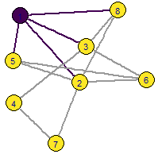
Node property: degree
Number of edges attached (incident) to node
If directed: in-degree and out-degree
Example: purple node has degree = 4

Slide 32
Quiz question
In an undirected network with 7 nodes, what is the maximum number of edges possible?
HINT: Think about how many ‘other’ nodes each node can be connected to
21
7 nodes can each connect with the 6 other nodes (7 x 6 = 42)…
…and the edge AB is also BA for undirected (42 / 2= 21)

Slide 33
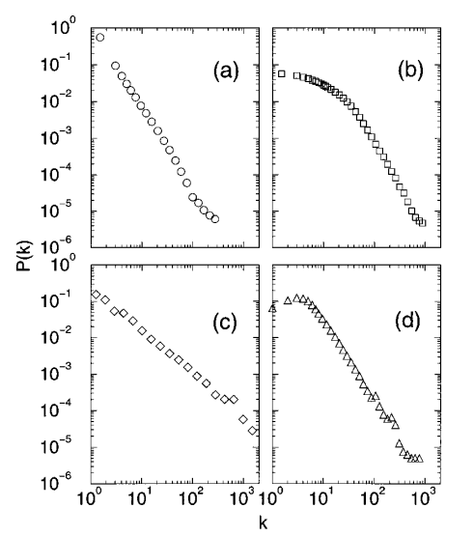
Scale-free degree distribution
Many real-world networks have highly skewed degree distributions
(a) internet
(b) movie actor collaboration
(c) co-authorship in high-energy physics
(d) co-authorship in neuroscience
Social networks that involve real world interactions do not have extremely high degree
Albert and Barabási (2002). Statistical mechanics of complex networks. doi: 10.1103/RevModPhys.74.47

Slide 34
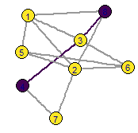
Shortest path (geodesic)
Shortest path is a property of pairs of nodes
Calculated for pairs of nodes
How many edges to get from one to the other
[4,8] has SP of 2
shortest path is 238
other paths include 4728, 4318, 436218, 4726318 or …

Slide 35
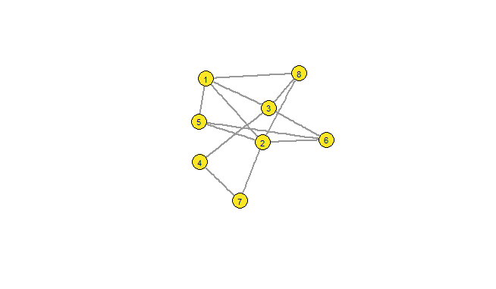
Node property: Betweenness
The more paths that must be traced through a node, the more central it is
Controls information that passes between sections of the network
Betweenness is the number of shortest paths passing through the node
Node 3 on shortest paths 48 and 46 and others
Node 3 is on some paths between 17 or 18, but not on shortest path

Slide 36
Quiz questions
What is the length of the longest geodesic in the network?
3 (between nodes 4 and 5)
Note: also called diameter
How many geodesics pass through node 3?
don’t count paths to node 3
5 (16, 48, 14, 45, 68)
Note: betweenness of 4 (45 and 68 are both 1 of 2)

Slide 37
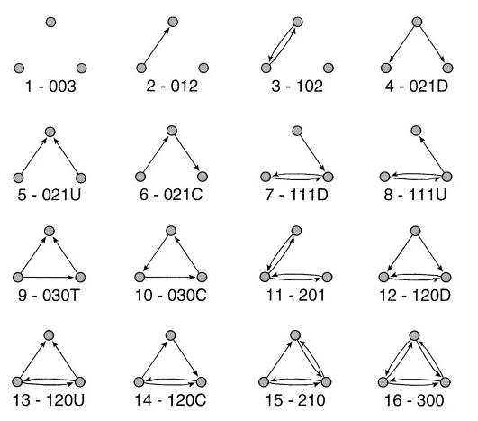
Triads: three nodes and their edges
Numbers indicate MAN reference (directed)
M is mutual
A is asymmetric
N is null (absent)
Final letter distinguishes those with same MAN
Cycle
Transitive
Up
Down

Slide 38
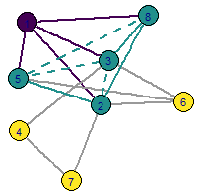
Node property: clustering coefficient
Conceptually if two people have a friend in common, likely to be friends themselves
Proportion of potential edges between neighbours that exist
OR Triangles centred on node
Example: purple node has cc = 0.5
4 neighbours
6 potential edges
3 actual edges

Slide 39
Quiz questions
Degree of node 6?
3
Clustering coefficient of node 6?
HINT: How many possible edges?
1/3

Slide 40
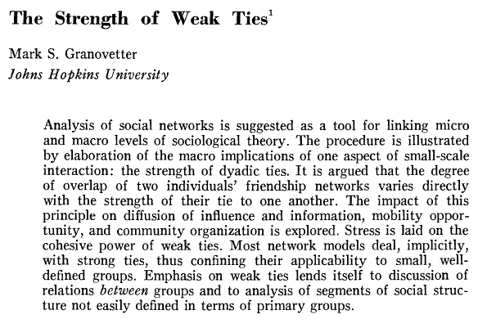
Strength of weak ties: theoretical consideration of triads
Strong relationships (close friends) are important in network structure
Weak ties access other areas of the network and have an important role in accessing new information
New ideas
Opportunities (such as job vacancies)

Slide 41
Other theories focussing on triads
Balance Theory
Creativity from Forbidden Triads
Heider (1958) argues that triads are balanced (stable) if an even number (or none) of negative relations
My friend’s friend is my friend My friend’s enemy is my enemy My enemy’s friend is my enemy My enemy’s enemy is my friend
Forbidden triads have high weight edges and an open potential edge
Expected that edge would close
Vedres (2017) argues that a high density of forbidden triads is associated with creative success
Intersection of separate communities
Hummer & Doreian (2003). Some dynamics of social balance processes: bringing Heider back into balance theory. doi: 10.1016/S0378-8733(02)00019-9
Vedres (2017). Forbidden triads and creative success in jazz: the Miles Davis factor. doi: 10.1007/s41109-017-0051-2

Slide 42
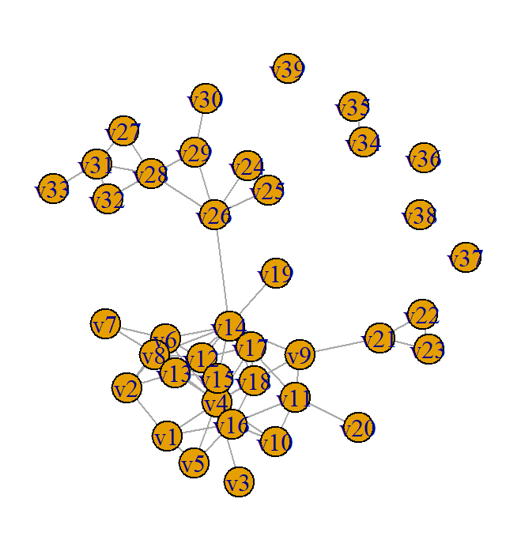
Meso-structure

Slide 43
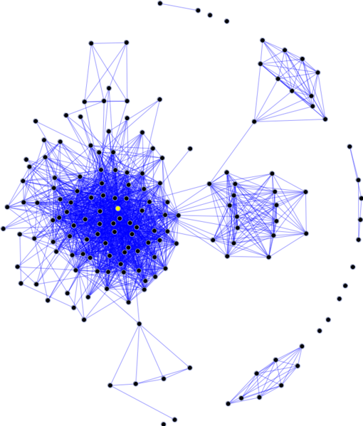
Larger structures
Community (or Cluster): area of relatively high edge density, separated by low density edges
Component: disconnected subnetwork
Isolate: disconnected node
Image source: https://commons.wikimedia.org/wiki/File:Sna_large.png

Slide 44
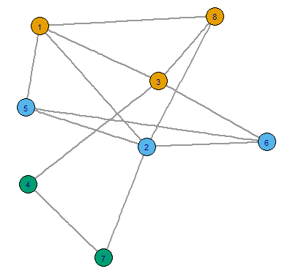
What is a community?
Communities are subnetworks where edges are between members more than connecting to other subnetworks
Different approaches to identify communities
Calculate betweenness of all edges, delete the edge with highest value, iterate
Random local walks
Brute force: trial and error to maximise modularity

Slide 45
Properties of the whole network
Density
Proportion of potential edges that are realised
Diameter
Length of the longest geodesic
Maximum distance to traverse
Centralisation
Distribution of node centrality
Homophily of an attribute
Measured as the correlation coefficient of the attribute over all pairs of nodes connected by an edge
Tendency for edges where the node pair have common attribute
Also termed assortativity, particularly if that property is degree (popularity)

Slide 46
Network property: Centralisation
Centralisation is a NETWORK level attribute
Concerns how much a single node dominates, or how evenly
distributed edges are across the network
other nodes are not considered
Calculated as:
Think of it as the difference between the maximum degree [or other centrality property] and the mean degree in a network
Σ (centrality of most central node – centrality of each node)
theoretical maximum of such Σ for networks with the same number of nodes

Slide 47
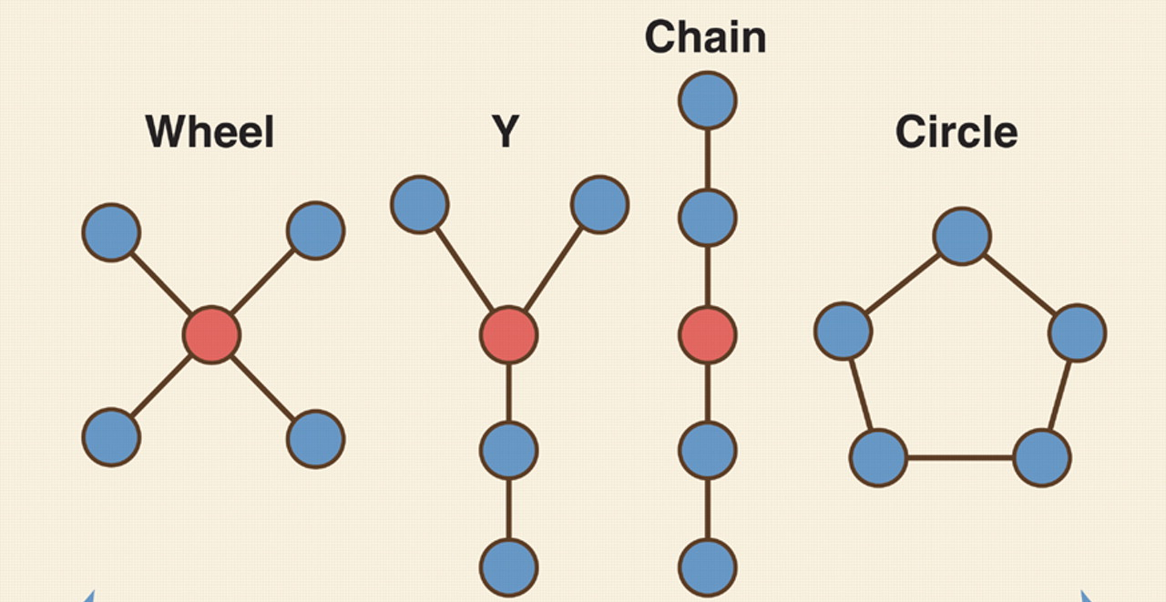
Network property: Centralisation
High centralisation Low centralisation

Slide 48
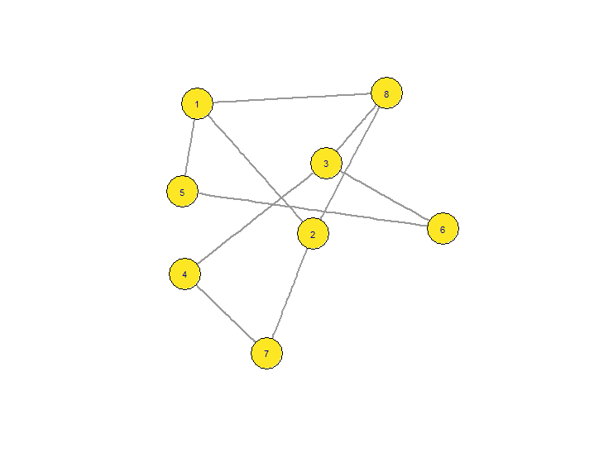
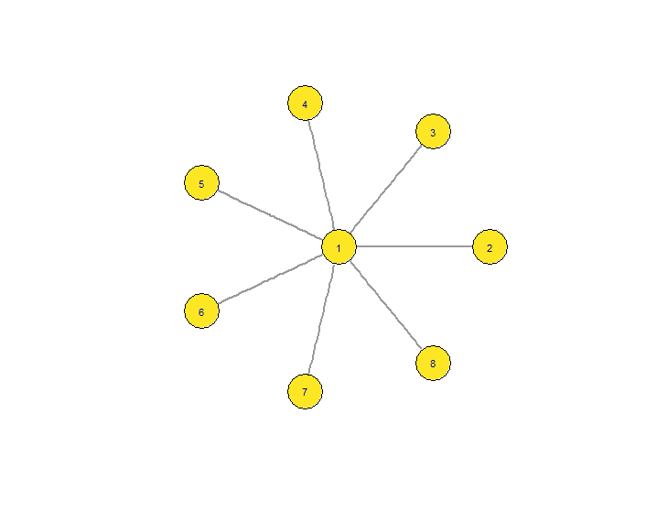
Quiz questions
Q6 Maximum degree for each network?
Q7 Rank the networks from most to least (degree) centralised
Hint: Don’t calculate, just compare the maximum degree to the typical degree
A6: 5
A6: 3
A6: 7
A
B
C
A7: C, A, B

Slide 49
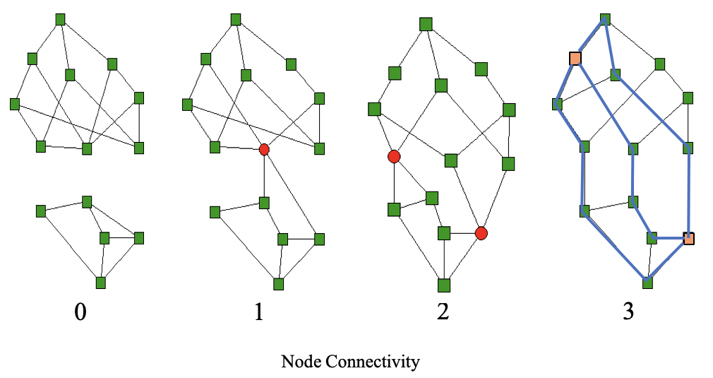
Cohesive networks remain connected even if nodes removed Multiple paths between nodes

Slide 50
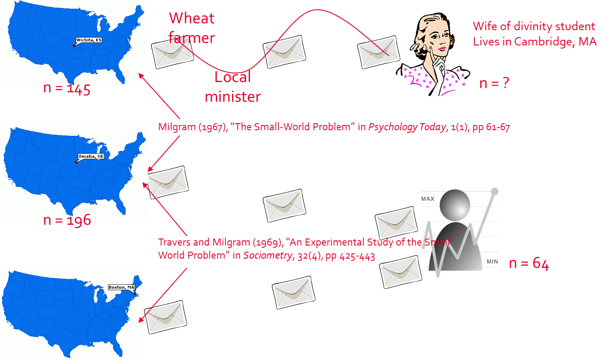
Small world: social networks have high clustering (triangles) but also short paths
Apparently inconsistent because triangles are local, so paths should be long
Mathematical models generated graphs with one or the other, but not both
Milgram experiments found average 6 steps (for completed chains)
Resolved by Watts and Strogatz
A small number of random edges substantially reduces average path length
DJ Watts, SH Strogatz (1998), Collective dynamics of ‘small-world’ networks, Nature 393 440:442

Slide 51
Network Dynamics
?
?
?
?
?

Slide 52
Two modes of diffusion through networks
Simple contagion
Epidemic spread, probabilistic each period of exposure
Idealised information diffusion
Complex contagion
Spread depends on the proportion of network neighbours already adopted
Idealised behaviour diffusion
?
?
?
?
?
Centola, D., Macy, M. (2007), “Complex contagion and the weakness of long ties” in American Journal of Sociology 113(3), 702–734

Slide 53
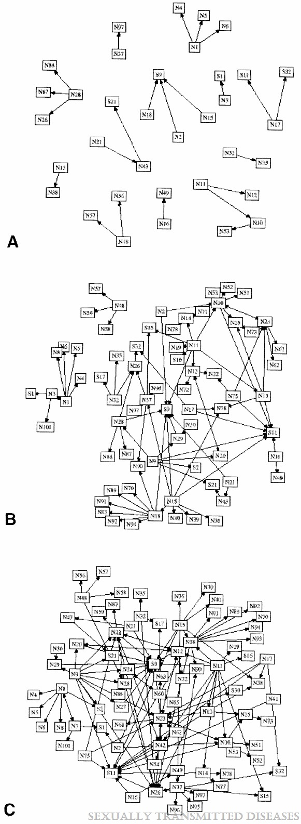
Communicable diseases spread via networks
Example study of a 1996 syphilis outbreak near Atlanta (US)
99 young people in sex party group over more than a year
10 eventually diagnosed with syphilis
Rothenberg et al (1998) compared traditional epidemiological tools to network based tools
Constructed sexual history networks at time points
Network visualisation highlighted the importance of specific girls who connected two separate groups of boys
Rothenberg et al (1998). Using Social Network and Ethnographic Tools to Evaluate Syphilis Transmission. Fig 2
https://journals.lww.com/stdjournal/Fulltext/1998/03000/Using_Social_Network_and_Ethnographic_Tools_to.9.aspx

Slide 54
Homophily: network neighbours have similar attributes
Homophily measured as the correlation of attribute values of the pairs of nodes at the ends of edges
Also referred to as assortativity, particular for degree
Social networks have positive assortativity, popular people are disproportionally friends with popular people
Similarity arises in two ways
Selection: choose similar friends
Dynamics of networks
Influence: change behaviour to be similar to friends
Dynamics over networks
The only way to differentiate is with longitudinal data

Slide 55
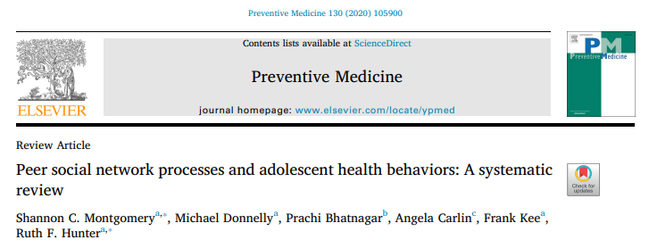
Networks associated with changes in behaviour
Health behaviour of adolescents similar to that of their friends
Substance use (tobacco, alcohol, drugs), physical activity

Slide 56
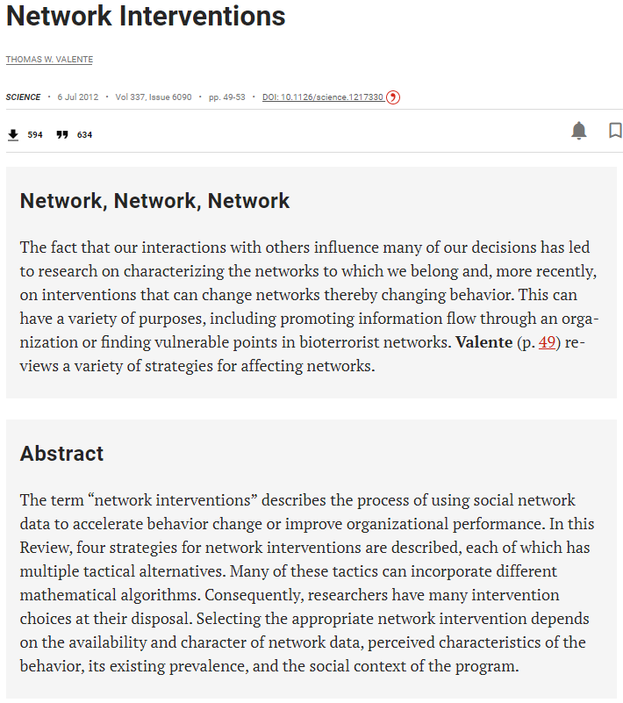
Opportunity for networks to be used in interventions
Individuals – select specific initial people
Leaders, bridges
Low threshold
Peripherals
Segmentation – tailor for groups
Induction – encourage extra communication
Alteration – change who interact with
Add to, or delete from, network

Slide 57

Networks
(wrap up)

Slide 58
Networks comprise BOTH the cases and the relationship
Cases or Entities
People, firms…
‘Nodes’ (or vertices, actors)
Relationship(s)
Friend, trade with…
‘Edges’ (or links, ties)
Network

Slide 59
Analysis methods suitable for different questions
Some properties concern the influence of a node within a network
Other properties concern the larger structure of the network
Centrality X > centrality Y for all networks shown

Slide 60

Next session: Social Network Analysis Workshop
Dataset
Korean villages
Adoption of family planning
Network measures to compare two villages with different adoption
Workshop will use R throughout
R packages (+ tidyverse)
igraph

Slide 61
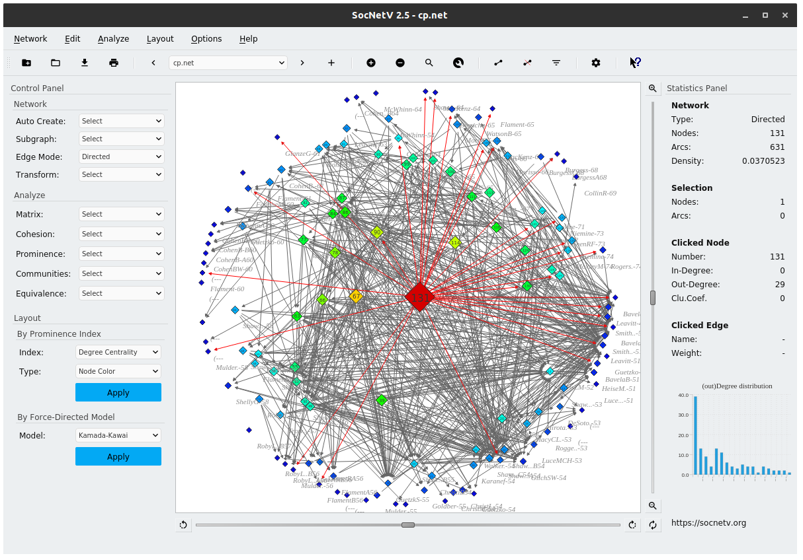
Alternative software: SocNetV
https://socnetv.org/

Slide 62
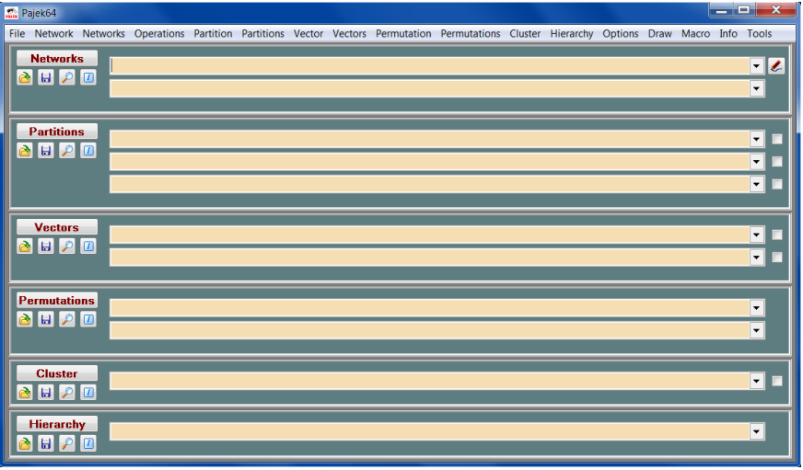
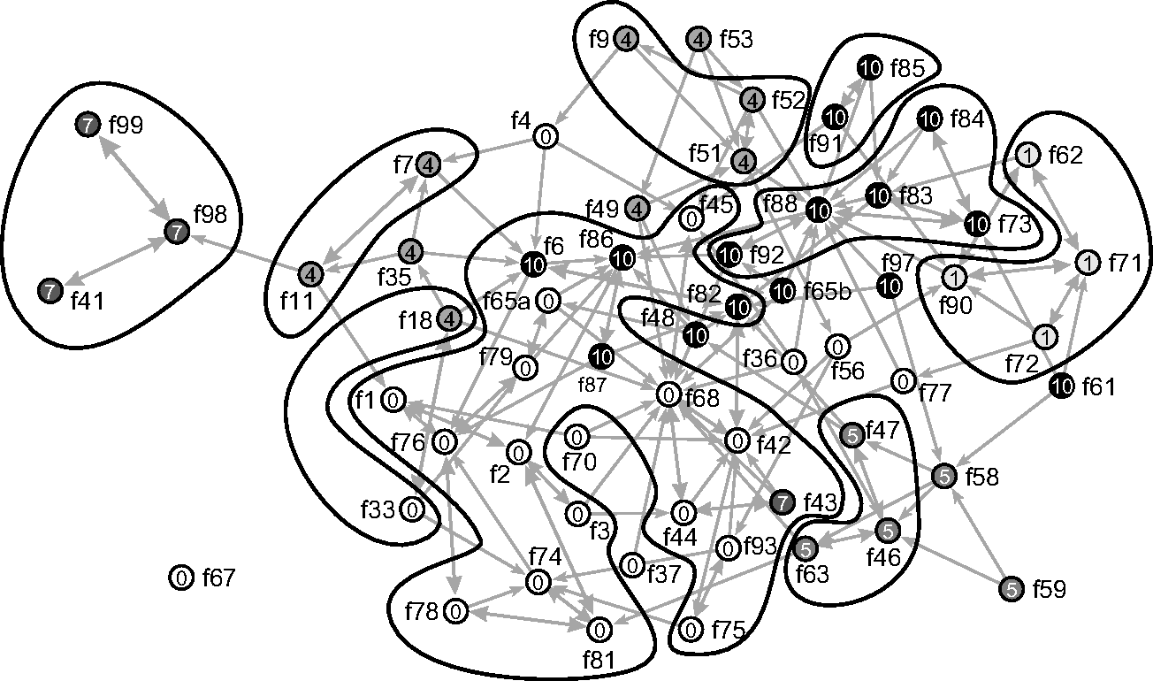
Alternative software: Pajek
http://mrvar.fdv.uni-lj.si/pajek/

Slide 63

Alternative software: GraphVis
https://networkrepository.com/graphvis.php

Slide 64
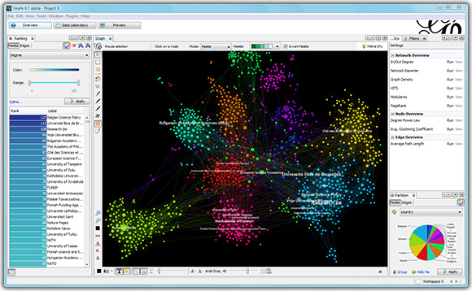
Alternative software: Gephi
https://gephi.org/

